Slide 1
Landroid
Autonomous Lawn Mower

Slide 2
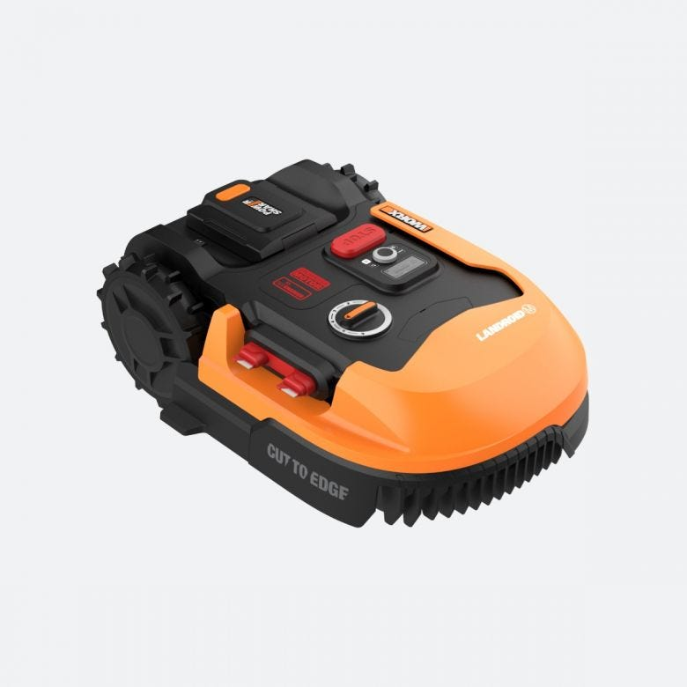
Landroid
Autonomous Lawn Mower moves inside a perimeter set by a wire.
Different Models defined by parts configuration.
Connects to Wi-Fi to be remoted monitored via mobile application.
Stops mowing if is raining.
Stops if identify an animal in the path.
Return to base to recharge when is needed.
Self test regularly for failure parts.

Slide 3
